Slide 1
RATHINAM
CENTRE OF EXCELLENCE
Database Management System
UML Diagrams – Sequence
by
Mrs.B.Sharmila
Technical trainer

Slide 2
Introduction to Sequence Diagram
The sequence diagram represents the flow of messages in the system and is also termed as an event diagram. It helps in envisioning several dynamic scenarios.
Purpose of a Sequence Diagram:
To model high-level interaction among active objects within a system.
To model interaction among objects inside a collaboration realizing a use case.
It either models generic interactions or some certain instances of interaction.

Slide 3
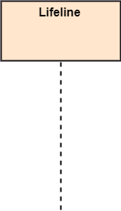
Notation of Sequence Diagram
Lifeline:
An individual participant in the sequence diagram is represented by a lifeline. It is positioned at the top of the diagram.

Slide 4

Notation of Sequence Diagram
Actor:
A role played by an entity that interacts with the subject is called as an actor.
It is out of the scope of the system.
It represents the role, which involves human users and external hardware or subjects. An actor may or may not represent a physical entity, but it purely depicts the role of an entity. Several distinct roles can be played by an actor or vice versa.

Slide 5
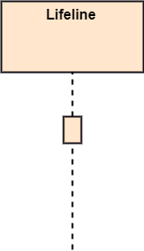
Notation of Sequence Diagram
Activation:
It is represented by a thin rectangle on the lifeline.
It describes that time period in which an operation is performed by an element, such that the top and the bottom of the rectangle is associated with the initiation and the completion time, each respectively.

Slide 6
Notation of Sequence Diagram
Messages:
The messages depict the interaction between the objects and are represented by arrows.
They are in the sequential order on the lifeline.
The core of the sequence diagram is formed by messages and lifelines.
Following are types of messages enlisted below:
Call Message
Return Message
Self Message
Recursive Message
Destroy Message
Duration Message
Note
Create Message

Slide 7
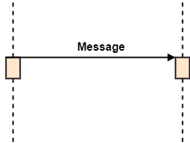
Call Message
It defines a particular communication between the lifelines of an interaction, which represents that the target lifeline has invoked an operation.

Slide 8
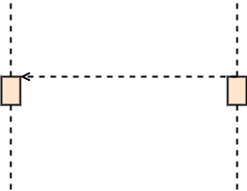
Return Message
It defines a particular communication between the lifelines of interaction that represent the flow of information from the receiver of the corresponding caller message.

Slide 9

Self Message
It describes a communication, particularly between the lifelines of an interaction that represents a message of the same lifeline, has been invoked.

Slide 10

Recursive Message
A self message sent for recursive purpose is called a recursive message. In other words, it can be said that the recursive message is a special case of the self message as it represents the recursive calls.

Slide 11
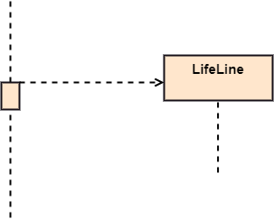
Create Message
It describes a communication, particularly between the lifelines of an interaction that depicts a request to destroy the lifecycle of the target.

Slide 12
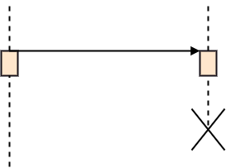
Destroy Message
It describes a communication, particularly between the lifelines of an interaction that depicts a request to destroy the lifecycle of the target.

Slide 13
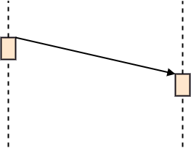
Duration Message
It describes a communication particularly between the lifelines of an interaction, which portrays the time passage of the message while modeling a system.

Slide 14

Note
A note is the capability of attaching several remarks to the element. It basically carries useful information for the modelers.

Slide 15
Benefits Of Sequence Diagram
It explores the real-time application
It has easy maintenance.
It is easy to generate.
It depicts the message flow between the different objects.
Implement both forward and reverse engineering.
It can easily update as per the new change in the system.

Slide 16
Drawbacks Of Sequence Diagram
In the case of too many lifelines, the sequence diagram can get more complex.
Since each sequence needs distinct notations for its representation, it may make the diagram more complex
The incorrect result may be produced, if the order of the flow of messages changes.
The type of sequence is decided by the type of message

